Slide 1
Data Preprocessing
By: Alek, Andrew, Houston, and Luke

Slide 2
The Dataset
16058 total data points
14 different variables
Describes calories, macros (such as protein, fat, carbs), nutrition facts, weight watchers points

Slide 3
Manipulating the Data
Dropped company and item (object types not floats)
Had 1370 missing data points
Filled in values with the average
Used describe to find mean, count, min, and max

Slide 4
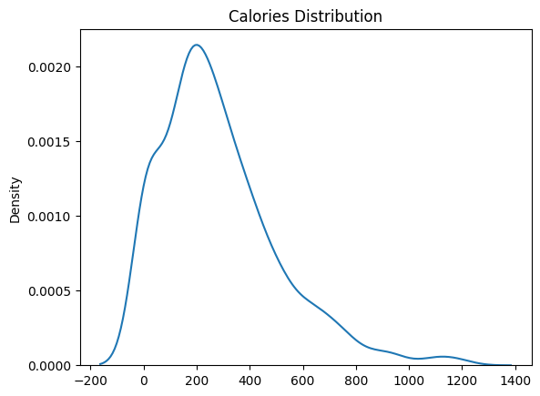
Exploring the Data
Using different visuals we analyzed the distribution of the data
Found the density of calories

Slide 5
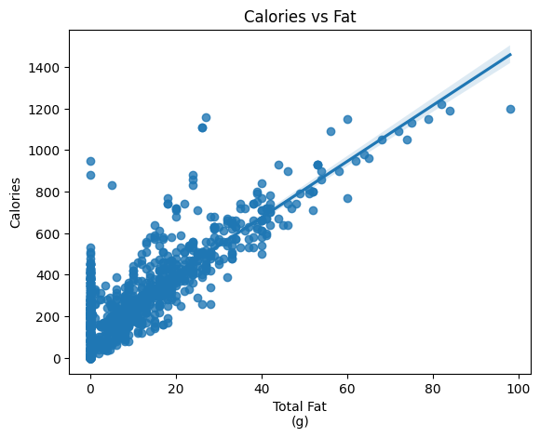
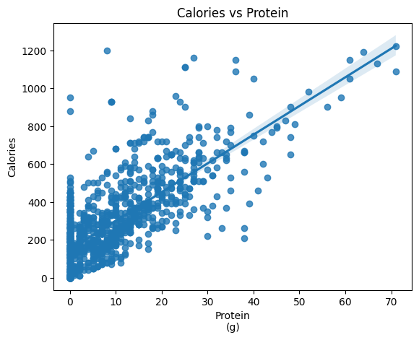
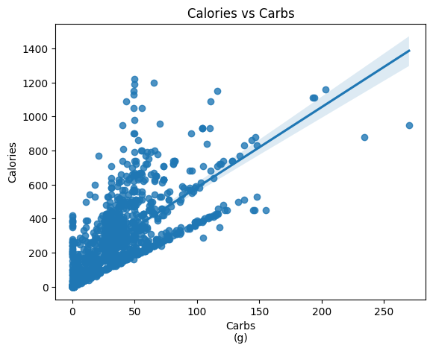
Calories vs Macro
Strong, positive relationships between calories and macros

Slide 6
Our Model
80% training / 20% testing
Linear Regression
Used to predict calories

Slide 7
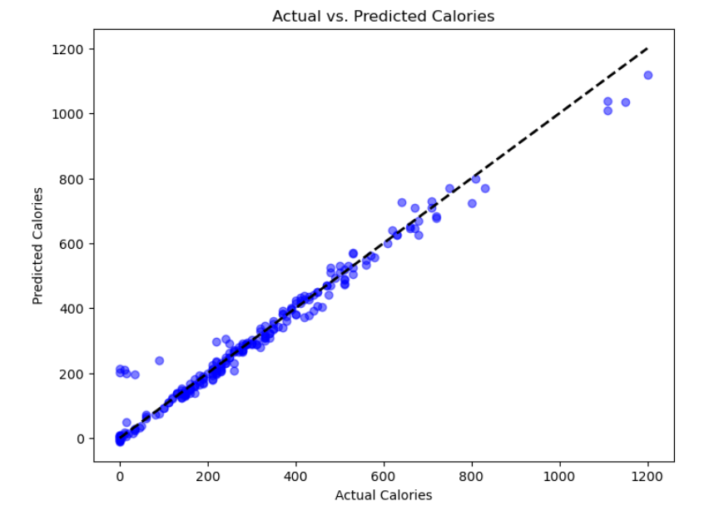
Predictive Model
R-squared: 0.97
Mean Squared Error: 1496.37
Root Mean Squared Error: 38.68
Mean Absolute Error: 20.99

